Slide 1

Practical Semantic Modeling, SPARQL, RDF Shapes, IoT/WoT/UoM
Vladimir Alexiev, PhD, PMP Created 25 Oct 2017, Updated 16 Apr 2018

Slide 2
Outline
RDF Formats
Semantic resolution and content negotiation
Prefixes, URL design (Namespace Carving)
RDF Terms, Turtle, SPARQL
Semantic Data Modeling
Semantic Modeling vs Ontology Engineering
RDFS vs schema.org; Ontology design patterns; RDF Shapes
Org, RegOrg, Person, Locn Ontologies
euBusinessGraph Data Model; rdfpuml diagramming tool
SPARQL
vocab.getty.org/queries Getty Sample Queries
businessgraph.ontotext.com/sparql sample queries (Bulgarian Trade Register)
Ontologies for IoT, WoT, UoM

Slide 3
RDF Formats

Slide 4
RDF Formats
By now you know RDF is an abstract graph data model
Various formats (serialiations) are used, e.g. see Getty LOD documentation
Format (.ext, MIME type):
RDF/XML (.rdf, application/rdf+xml): oldest, mandated by several specifications, hardest to read, quite hard to process (because the same RDF can be expressed in many different RDF/XML forms)
Turtle (.ttl, text/turtle): the most readable format.
N-Triples (.nt, application/n-triples): simple line-oriented format, easy to process with Unix command-line tools.
RDF/JSON (.json or.rj, application/rdf+json): old JSON format that is not used much anymore.
JSONLD (.jsonld, application/ld+json; also see home page): modern format, easier to consume by web applications. It’s JSON with extra mechanisms to make it RDF:
Context: defines prefixes, datatypes, prop/class abbreviations, etc
Frame: defines how to pick from a graph and how to linearize it

Slide 5
SPARQL Tabular Formats
The above were formats for semantic resources and SPARQL CONSTRUCT/DESCRIBE queries.
SPARQL SELECT/ASK queries return Tabular formats:
SPARQL XML (.xml or .srx, application/sparql-results+xml): supported by most SPARQL client frameworks
SPARQL JSON (.json or .srj, application/sparql-results+json): supported by most SPARQL client frameworks, easier to parse by web applications
SPARQL CSV (.csv, text/csv: comma separated values): useful for some end-user tools like Excel and OpenRefine.
SPARQL TSV (.tsv, text/tab-separated-values): useful for some end-user tools like Excel and OpenRefine.

Slide 6
Semantic Resolution and Content Negotiation
See e.g. Getty documentation on the topic
Follow recommendation Cool URIs for the Semantic Web
Follow Best Practice Recipes for Publishing RDF Vocabularies
Validate the resolution with Vapour (source location)
Use HTTP URLs for semantic URIs
Semantic resolution
Each URL should resolve, returning human or machine readable content
Content negotiation: use Accept request header with specific MIME type curl -Haccept:text/turtle http://vocab.getty.edu/aat/300011154
(Extra practice) Direct URL: use the URL with file extension e.g. http://vocab.getty.edu/aat/300011154.html vs http://vocab.getty.edu/aat/300011154.rdf
Use 303 redirect (see next)
·

Slide 7
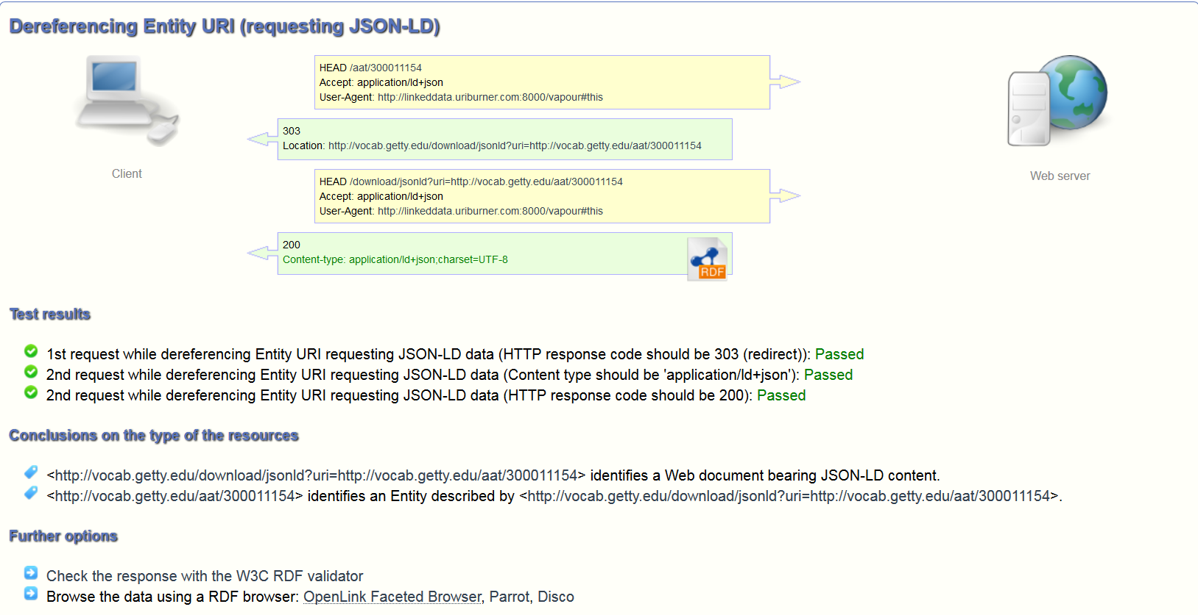
Vapour Validation
E.g. conneg of http://vocab.getty.edu/aat/300011154 as JSON-LD

Slide 8
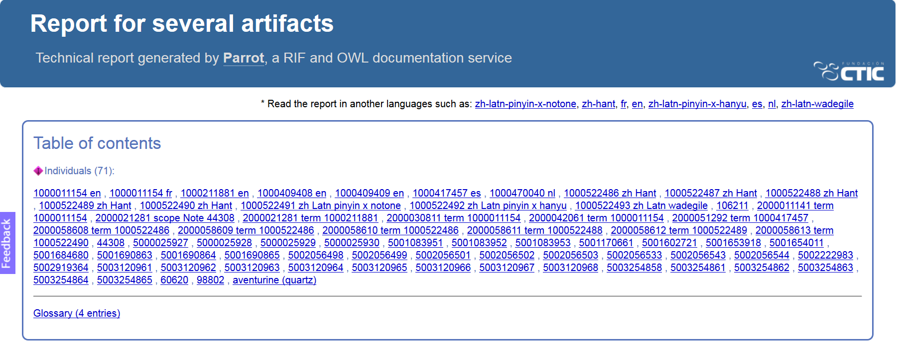
Business-Meaningful Entities (1)
The same resource returns 71 nodes and their triples: all subsidiary data (concept, labels, provenance…). Check with Parrot:

Slide 9
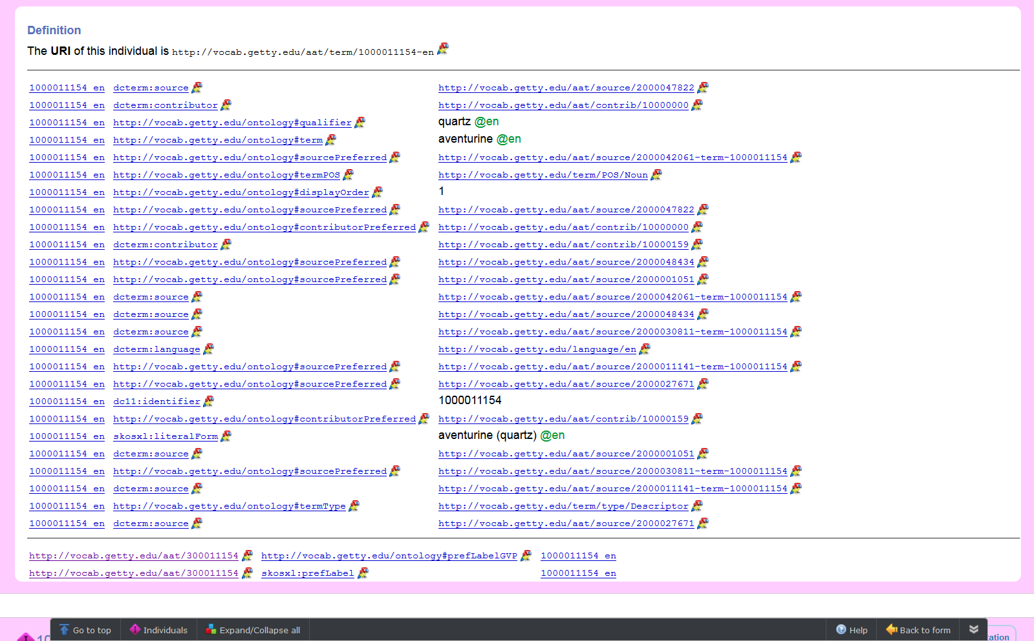
Business-Meaningful Entities (2)

Slide 10
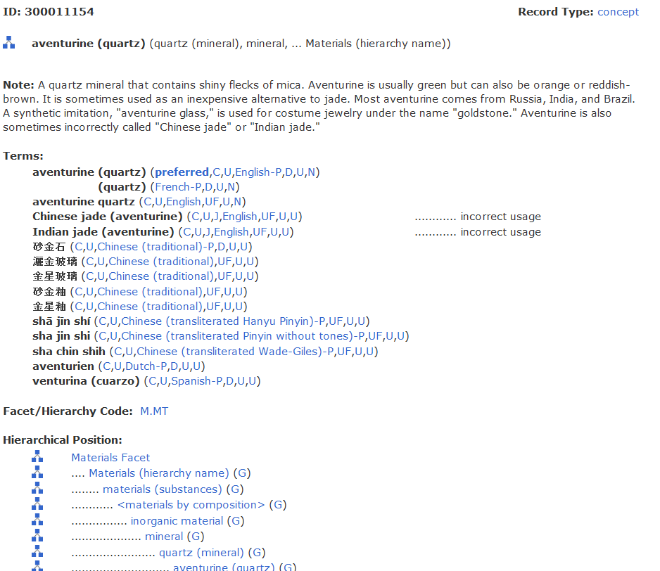
Business-Meaningful Entities (3)
Same info at Getty website (2 more pages)

Slide 11
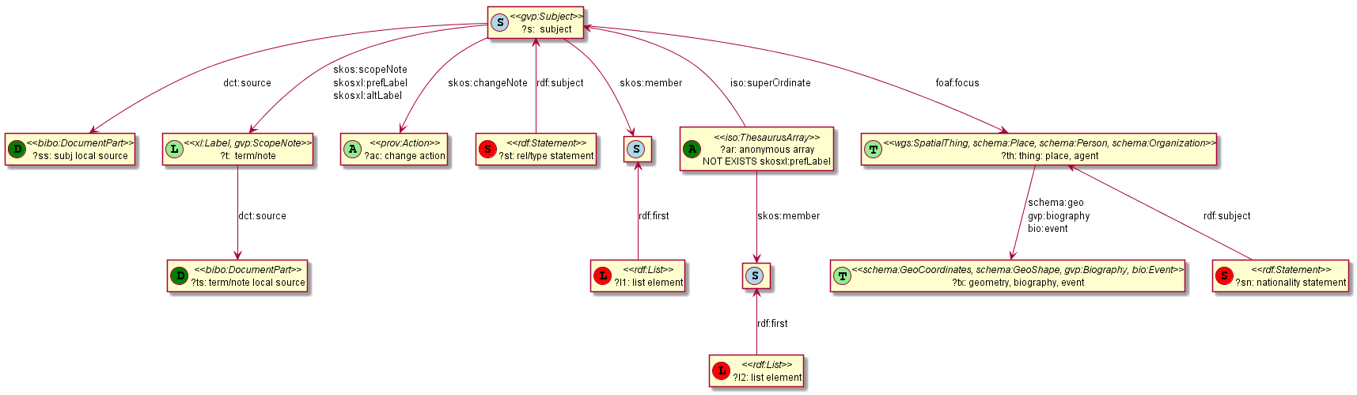
Business-Meaningful Entities (4)
The following info is returned (all statements at each node):

Slide 12
Business-Meaningful Entities (5) Best Practices
DESCRIBE should return the same full entity
SPARQL leaves DESCRIBE under-specified
Many repositories return Compound Bounded Description (CBD) and Symmetric Compound Bounded Description (SCBD)
But these use Blank nodes to describe the subsidiary data
While Blank nodes make other sorts of trouble (the data is harded to debug)
Using RDF standards ensures that third party apps can display and use this data.

Slide 13
RDF Terms: URIs
RDF graphs are made of triples (S,P,O) or quads (S,P,O,G) and three kinds of terms:
URI (IRI): used in any position (S,P,O,G), HTTP URL/IRI preferred
<http://dbpedia.org/resource/Protégé_(software)> (not /page)
<http://www.wikidata.org/entity/Q2066865> (not /wiki)
<http://bg.dbpedia.org/resource/Левски> (any UTF8 allowed)
<http://dbpedia.org/ontology/abstract> (e.g. property)
<http://www.w3.org/2002/07/owl#sameAs> (slash vs hash)
<mailto:Vladimir.Alexiev@ontotext.com> (email)
<tel:+359123456789> (phone)
<geo:21.2413,42.37858> (geo location)
Slash requests individual resource, used when there are many
Hash requests the whole “file”, used often for ontologies

Slide 14
RDF Terms: Blank Nodes, Literals
Blank nodes: used for resources (S,O). Unique in file only, local name doesn’t matter
_:ab134f13dc. Could be translated to e.g.
_:foo on export
But two instances of _:ab134f13dc will be translated to the same _:foo
Use only if you’re too lazy to mint intermediate URIs. But useful in SPARQL and hand-written Turtle
Literals: string with optional datatype or language
"foo" : plain string
"foo"^^<http://www.w3.org/2001/XMLSchema#string> : exactly the same (RDF 1.1)
"42"^^<http://www.w3.org/2001/XMLSchema#integer> : integer (any number of digits)
"2017-10-24"^^<http://www.w3.org/2001/XMLSchema#date> : date
"7444723"^^<http://data.businessgraph.io/register/UK> : use your own datatype
"fries"@en-US, "chips"@en-GB, "papas fritas"@es, "пържени картофи"@bg : language
UTF8 chars, common escapes (e.g. \uXXXX, \n newline, \t tab, etc)

Slide 15
RDF Lang Tags
What languages can one use? See Getty documentation
Standard: IANA Language Subtag Registry (described in BCP47 sec 3.1). Google Sheet iana-lang-tags is easier to use:
7769 languages
227 extlangs, e.g. ar-auz (Uzbeki Arabic)
116 language collections, e.g. bh (Bihari languages)
62 macrolanguages, e.g. zh (Chinese), cr (Cree)
4 special languages, e.g. und (Undetermined)
162 scripts, eg Latn (Latin), Cyrl (Cyrillic), Japn (Japanese)
301 regions, e.g. US (United States), 021 (Northern America)
61 variants
Also private (custom) languages, scripts, modifiers

Slide 16
NTriples
Simple line-oriented format, easy to parse with Unix command line tools
Extremely wordy, impossible to read (example)
Repositories store triples like this but:
URIs and literals are put in a "resource pool", then triples recorded against resource IDs
GraphDB also does sameAs clustering (optimization)
Need for prefixes and shortcut notations
<http://dbpedia.org/resource/Prot\u00E9g\u00E9_(software)> <http://dbpedia.org/ontology/programmingLanguage> <http://dbpedia.org/resource/Java_(programming_language)> .
<http://dbpedia.org/resource/Prot\u00E9g\u00E9_(software)> <http://www.w3.org/1999/02/22-rdf-syntax-ns#type> <http://www.wikidata.org/entity/Q386724> .
<http://dbpedia.org/resource/Prot\u00E9g\u00E9_(software)> <http://www.w3.org/1999/02/22-rdf-syntax-ns#type> <http://dbpedia.org/class/yago/PhysicalEntity100001930> .
<http://dbpedia.org/resource/Prot\u00E9g\u00E9_(software)> <http://www.w3.org/2002/07/owl#sameAs> <http://de.dbpedia.org/resource/Prot\u00E9g\u00E9_(Software)> .
<http://dbpedia.org/resource/Prot\u00E9g\u00E9_(software)> <http://www.w3.org/2000/01/rdf-schema#label> "Prot\u00E9g\u00E9"@zh .
<http://dbpedia.org/resource/Prot\u00E9g\u00E9_(software)> <http://www.w3.org/2002/07/owl#sameAs> <http://dbpedia.org/resource/Prot\u00E9g\u00E9_(software)> .
<http://dbpedia.org/resource/Prot\u00E9g\u00E9_(software)> <http://xmlns.com/foaf/0.1/name> "Prot\u00E9g\u00E9"@en .

Slide 17
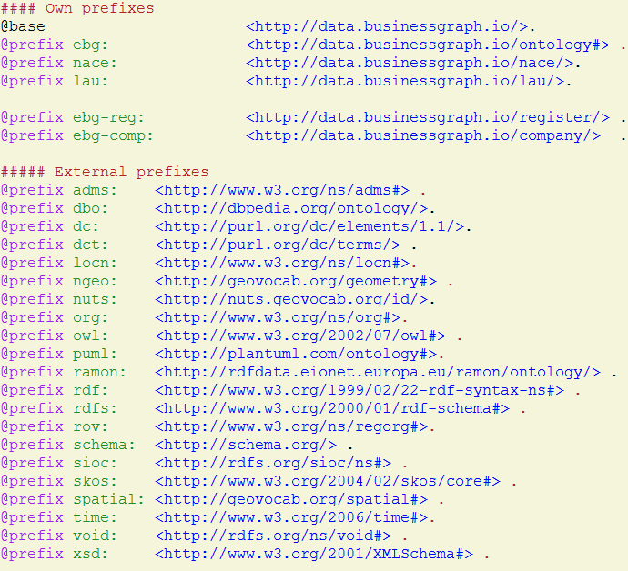
Prefixes
Obvious need to shorten URIs using prefixes
prefix.cc global register, e.g. http://prefix.cc/rdf,rdfs,owl,xsd.ttl
and similar for SPARQL http://prefix.cc/rdf,rdfs,owl,xsd.sparql
For any project, define prefixes.ttl, use it globally & consistently
No prefixes in individual Turtles: prepend the global
Load it in GraphDB and it will automatically add prefixes in SPARQL editor
Chars you can use in prefixed names: alphanumeric, dash, dot, parentheses
Can't use slash, braces, brackets
But GraphDB resource display shortens even more aggressively
@prefix rdf: <http://www.w3.org/1999/02/22-rdf-syntax-ns#>.
@prefix rdfs: <http://www.w3.org/2000/01/rdf-schema#>.
@prefix owl: <http://www.w3.org/2002/07/owl#>.
@prefix xsd: <http://www.w3.org/2001/XMLSchema#>.
PREFIX rdf: <http://www.w3.org/1999/02/22-rdf-syntax-ns#>
PREFIX rdfs: <http://www.w3.org/2000/01/rdf-schema#>
PREFIX owl: <http://www.w3.org/2002/07/owl#>
PREFIX xsd: <http://www.w3.org/2001/XMLSchema#>

Slide 18
Turtle
A number of shortcuts to allow easier writing and reading of RDF
Free form (not limited to specific line breaks), # comments
Base and Prefixes: <company/UK/2176594> rov:registration <company/UK/2176594/id>
"a" instead of rdf:type: <company/UK/2176594> a rov:RegisteredOrganization
Predicate list: <company/UK/2176594> a rov:RegisteredOrganization ; rov:registration <company/UK/2176594/id>
Object list: <company/ATOKA/6da785b3adf2> adms:identifier <company/ATOKA/6da78/id> , <company/ATOKA/6da78/id/REA>.
Blank node: [ ] (no data) or [p1 o1; p2 o2, o3] (with data) <company/ATOKA/6da785b3adf2> adms:identifier [skos:notation "TN210089"^^<register/IT/REA/TN>; dct:creator <register/IT/REA/TN>]
If you need the same blank node to be shared (have 2 incoming links), you need to use the normal notation _:foo
Blank nodes make it harder to debug data. For production, better mint reasonable URLs even for intermediate nodes

Slide 19
Turtle Literals
123: xsd:integer
123.45: xsd:decimal
true, false: xsd:Boolean
""" string with "double quotes" """
''' string with 'single quotes' '''

Slide 20
RDF Lists in Turtle
RDF natively supports multi-valued props, e.g. <person/1> foaf:name "Vladimir", "Vlado". <paper/1> schema:author <person/1>, <person/2>.
But there's no order: if you need it, could use RDF List. Deceptively easy in Turtle (note: no commas!) <paper/1> schema:authorList (<person/1> <person/2>).
But this is quite complex in RDF. Gets expanded to a linked list <paper/1> schema:authorList [a rdf:List; rdf:first <person/1>; rdf:rest [a rdf:List; rdf:first <person/2>; rdf:rest rdf:nil]]
Could also use "position" or "order" field, e.g. in schema.org (see #1727) <work> a CreativeWork; author <work/authors>. <work/authors> a ItemList; itemListOrder ItemListOrderAscending; itemListElement <work/author/1>, <work/author/N>. <work/author/1> a ListItem; item <author/1>; position 1. <work/author/N> a ListItem; item <author/N>; position N.

Slide 21
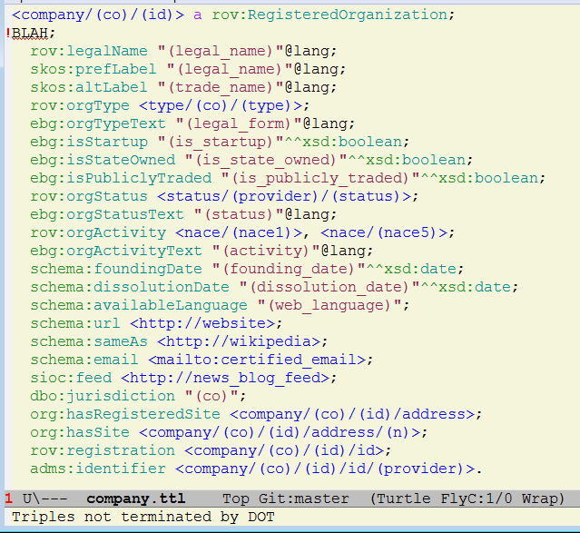
Turtle Editors: Emacs
I use Emacs:
syntax highlighting
Flycheck on-the-fly syntax checking
Uses Jena RIOT (riotval)
With custom script to prepend prefixes, and subtract line numbers from error messages

Slide 22
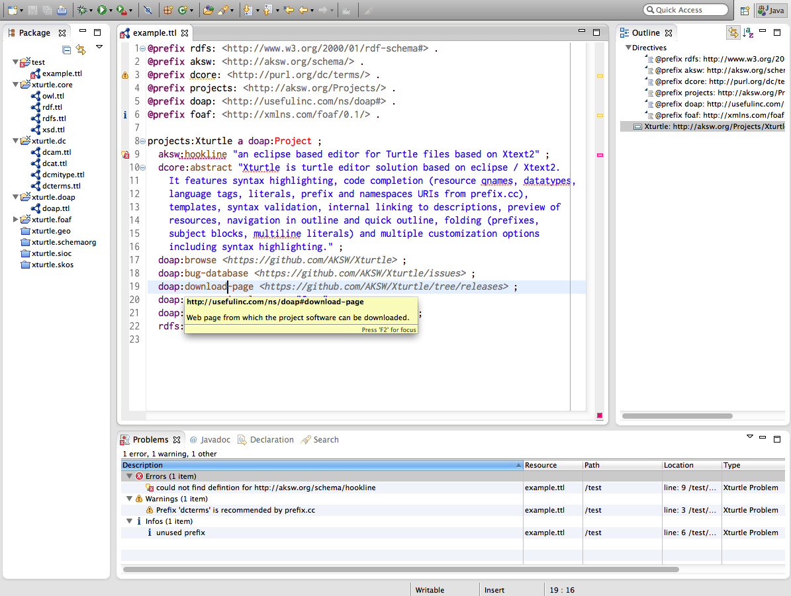
Turtle Editors: XTurtle
AKSW XTurtle
based on Eclipse / Xtext2
syntax highlighting,
code completion (resource qnames, datatypes, language tags, literals, prefixe and prefix.cc),
templates, syntax validation,
internal linking to descriptions,
preview of resources,
navigation in outline and quick outline,
folding (prefixes, subject blocks, multiline literals)
multiple customization options

Slide 23
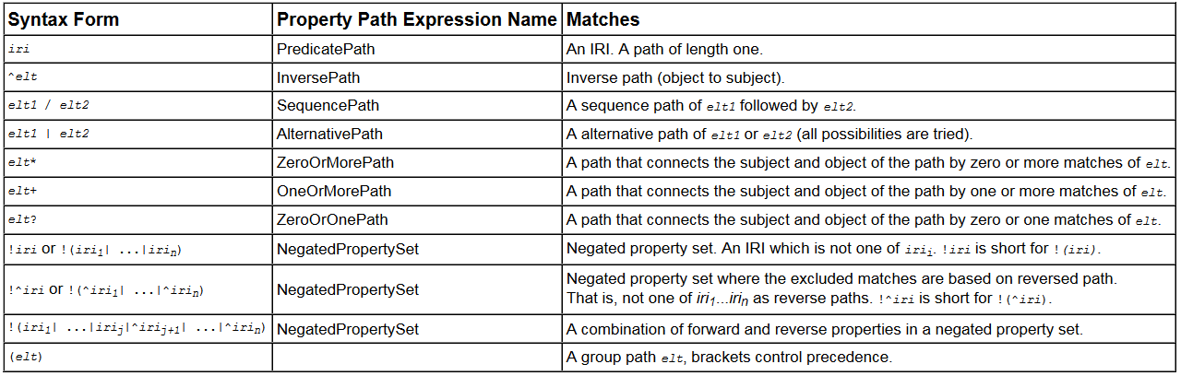
SPARQL vs Turtle
SPARQL Basic Graph Patterns use the same shortcuts as Turtle, and in addition:
Variables (in any position) ?s ?p ?o : sample all triples ?s a rov:RegisteredOrganization; ?p ?o : get all triples of RegOrg
$param used to indicate externally bound query param; ?var is free query variable
Property paths

Slide 24
Property Paths vs Blank Nodes
These are equivalent (give me string prefLabel, don't need label's node) ?x xl:prefLabel / xl:literalForm ?label : prop path ?x xl:prefLabel [xl:literalForm ?label] : blank node
But blank nodes allow more tests on the same node (only labels in English) ?x xl:prefLabel [xl:literalForm ?label; dct:language gvp_lang:en]
Inverse paths are occasionally useful but not necessary: ?x ^prop ?y is same as ?y prop ?x
Non-positive paths * and ? suffer from performance bug : rdf4j#689, rdf4j#695 (soon to be fixed in GraphDB as well)

Slide 25
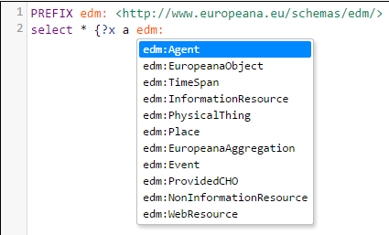
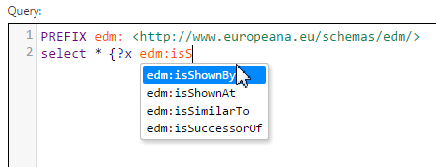
SPARQL Editing
Prefix automatic addition
Property and class auto-completion (if respective ontologies are loaded)

Slide 26
Semantic Modeling

Slide 27
Ontologies, Taxonomies, Knowledge Graphs
Ontologies: "database schemas" of RDF data
Determine the vocabularies of classes and properties to use
Also describe class and property hierarchies, class constructs, property characteristics, property constructs
Use various formalisms, e.g. RDFS, RDFS Plus, Schema domain/rangeIncludes, OWL (Full, DL, RL, QL, EL)
Taxonomies:
Vocabularies/nomenclatures of key values, with multilingual labels, hierarchy, lateral links
Usually formalized in the Simple Knowledge Management System (SKOS) ontology
Knowledge Graph (or KB):
Individuals and taxonomies capturing some domain
Expressed in some ontologies and according to some data model
Attributes and relations between individuals
Usually created through semantic data integration

Slide 28
Semantic Modeling vs Ontology Engineering
Ontology engineering: create ontology of a certain domain
Must find good balance between expressivity and flexibility/reusability of the model
Semantic modeling: how to represent a certain domain in RDF:
Be aware of relevant ontologies and datasets (KBs)
Design how to represent the data
Enable stakeholder/SME contribution, e.g. through Web Protégé, Excel or Google Sheet (Excel-based ontology engineering ™)
Engineer/add to ontologies where they are lacking
Design URL policies (Namespace carving)
Document the model (e.g. Getty doc: 100 pages
Create sample queries (e.g. Getty queries: over 100)
Create RDF Shapes and validation mechanisms
Ontology engineering is a subset of semantic modeling

Slide 29
Ontology Engineering
Various methodologies e.g.
NeOn Methodology (NEON book)
Protégé Simple Knowledge Engineering (Ontology Development 101)
Methontology: From Ontological Art Towards Ontological Engineering (AAAI 1997)
Kanga/ROO: uses Controlled Natural Language (CNL 2009, OWLED 2008, WSJ 2010)
DILIGENT, HCOME, OnTo Knowledge methodology, …
Ontology Requirements Specification Document
How to Write and Use ORSD
E.g. ORSD for PPROC (Public Procurement ontology)
Competence Questions
Towards Competency Question-driven Ontology Authoring (ESWC 2014)
Lecture from Manchester COMP60421: Ontology Engineering for the The Semantic Web (2014)
Top-level Ontologies
BFO, DOL/DOLCE, SUMO, UFO
CIDOC CRM for history, cultural heritage, archaeology

Slide 30
Ontology Design Patterns
Patterns describe ready solutions for various situations
Some are expressed as small ontology modules you can reuse
Others are patterns that need to be implemented in the specific context
Anti-patterns are examples of bad modeling
Resources
Towards a Catalog of OWL-based Ontology Design Patterns (NEON project)
Ontology Design Patterns site by ODP Association
Workshop on Ontology Patterns (2009-2017)
E.g. A pattern-based ontology for the Internet of Things, WOP 2017
Ontology Engineering with Ontology Design Patterns: Foundations and Applications (IOS Press 2016)

Slide 31
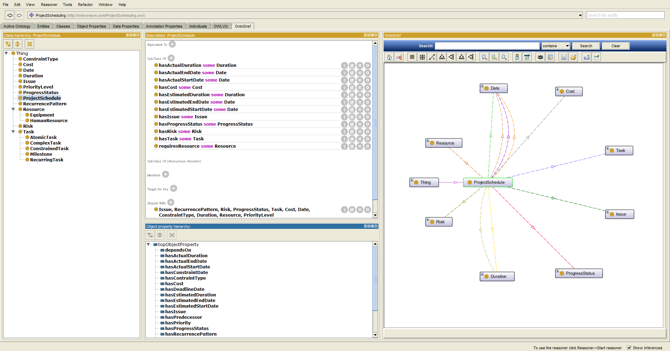
Ontology IDEs
Commercial: TopBraid Composer, Enterprise Vocabulary Net
Open source: Protégé, Web Protégé

Slide 32
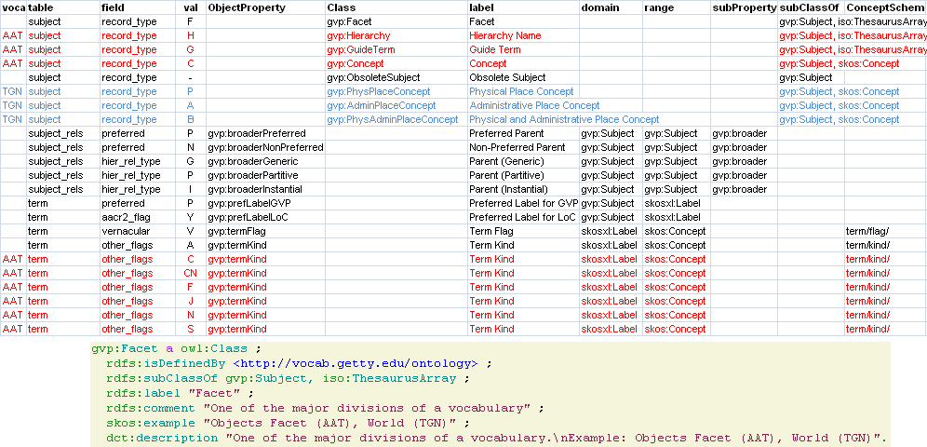
Generating Ontologies from Excel
E.g. Getty Vocabulary Program Classes, Schemas, Values

Slide 33
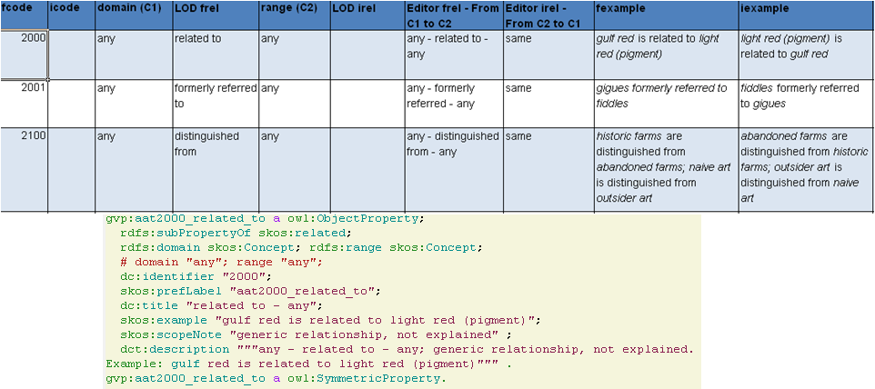
Generating Ontologies from Excel
E.g. Getty Vocabulary Program Associative Relations
Another part is written by hand

Slide 34
Generating from Google Sheets with TARQL
TARQL allows to make CONSTRUCT queries over TSV/CSV data
construct {
?classUrl
a owl:Class;
rdfs:isDefinedBy peo: ;
rdfs:label ?class;
rdfs:subClassOf ?subClassOfUrl;
skos:definition ?definition;
skos:example ?example;
skos:scopeNote ?scopeNote;
rdfs:comment ?comments.
}
from <https://docs.google.com/spreadsheets/d/17h5eoqMQea1D2vYfP4SRDvuCoBViloV6VTBq4WnmSk8/pub?gid=0&single=true&output=tsv#delimiter=tab>
where {
bind(tarql:expandPrefixedName(concat("peo:",?class )) as ?classUrl )
bind(tarql:expandPrefixedName(concat("peo:",?subClassOf)) as ?subClassOfUrl)
}

Slide 35
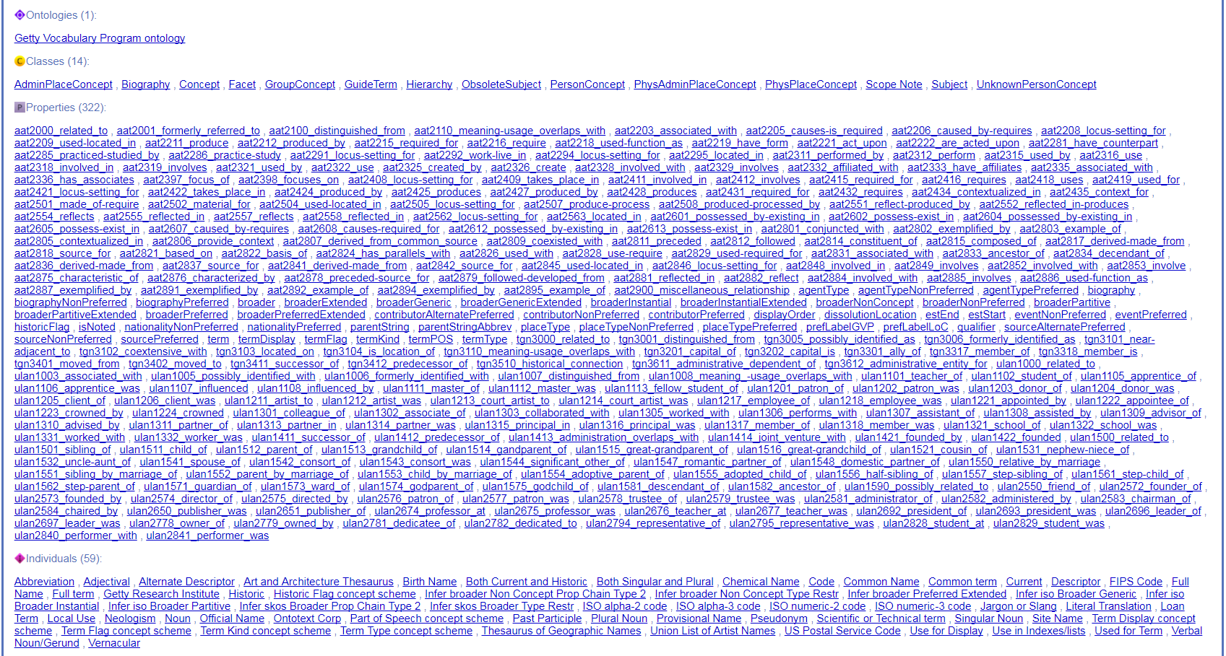
Result: GVP Ontology

Slide 36
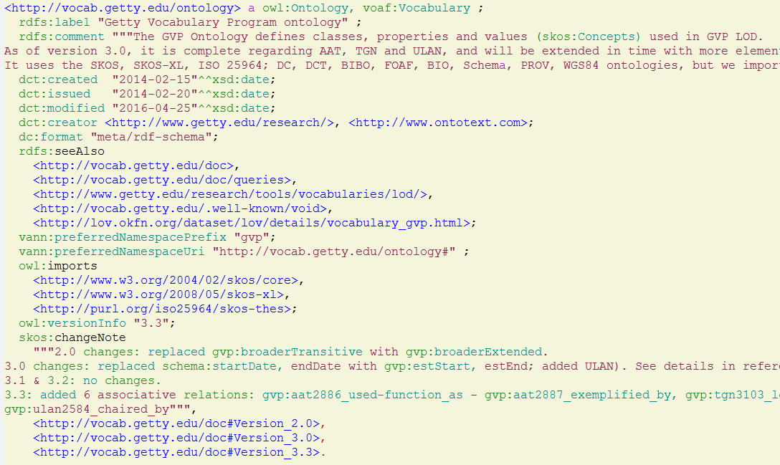
Documenting Ontologies
Descriptive Metadata

Slide 37
Common Ontology Problems
rdfs:domain/range don't constrain, they infer
ex:name rdfs:domain ex:Person, ex:Organization would make every resource with ex:name be both ex:Person and ex:Organization, which is obviously not what we want
They are monomorphic, i.e. apply to only one class. This causes:
Deep/abstract class hierarchy (owl:Thing, ex:Thing or ex:Nameable), or
Complex OWL constructs (owl:unionOf), or
Splitting props by domain, e.g. ex:nameOfOrg vs ex:nameOfPerson, which is even worse
schema:domainIncludes/rangeIncludes are descriptive not prescriptive
Polymorphic, this is ok: ex:name schema:domainIncludes ex:Person, ex:Organization
Facilitates a lot more flexible and reusable ontologies
Dictated from schema.org's need to accommodate web-scale data (e.g. 44B triples from 5.6M domains in Oct 2016 common crawl)
Used in EBG model (euBusinessGraph) and SOSA (Sensor, Observation, Sample, and Actuator)
Need to complement with model diagrams, RDF Shapes for validation

Slide 38
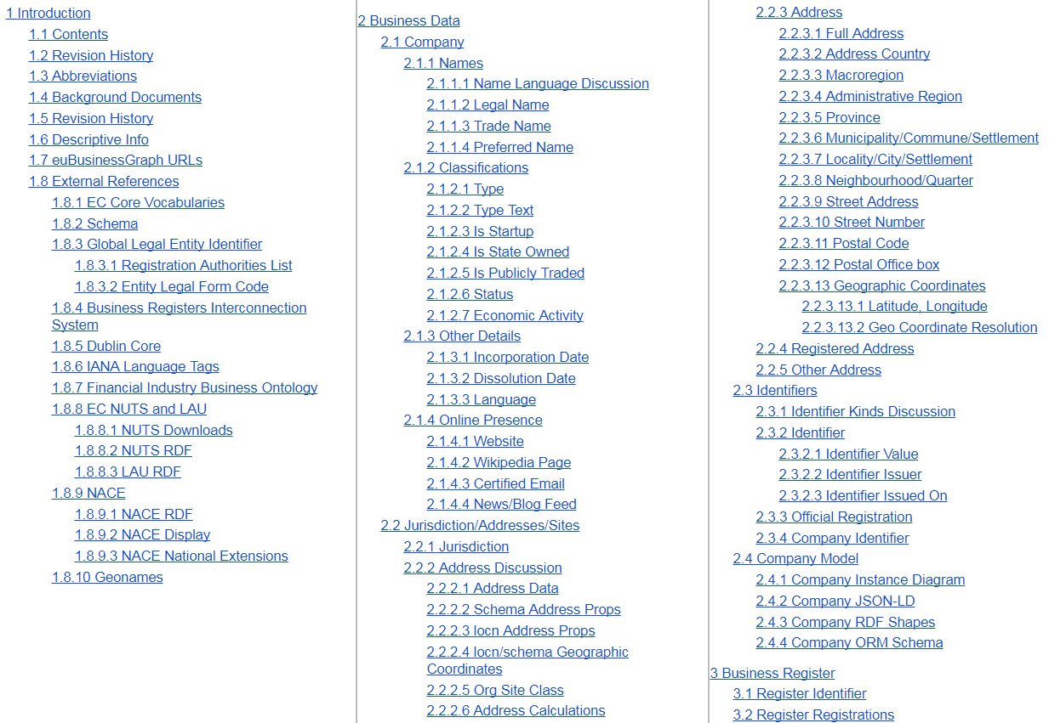
euBusinessGraph Semantic Data Model

Slide 39
euBusinessGraph Semantic Data Model
Reuses these ontologies:
ADMS (Asset Description Metadata Schema): identifiers
DBO (DBpedia Ontology): jurisdiction
DC, DCT (Dublin Core): identifier issuer, date
LOCN (Location): addresses
NGEO (Neo Geo) and Spatial: spatial inclusion
NUTS (Nomenclature of EU admin units): administrative region hierarchy
RAMON (Eurostat metadata): NUTS attributes
Org (Organizations)
RegOrg (Registered Organizations)
schema.org: founding/dissolution date, email, telephone, website…
SIOC (Semantically-Interlinked Online Communities ): blog / news feed
SKOS (Simple Knowledge Organization System): various nomenclatures, e.g. legal form, status

Slide 40
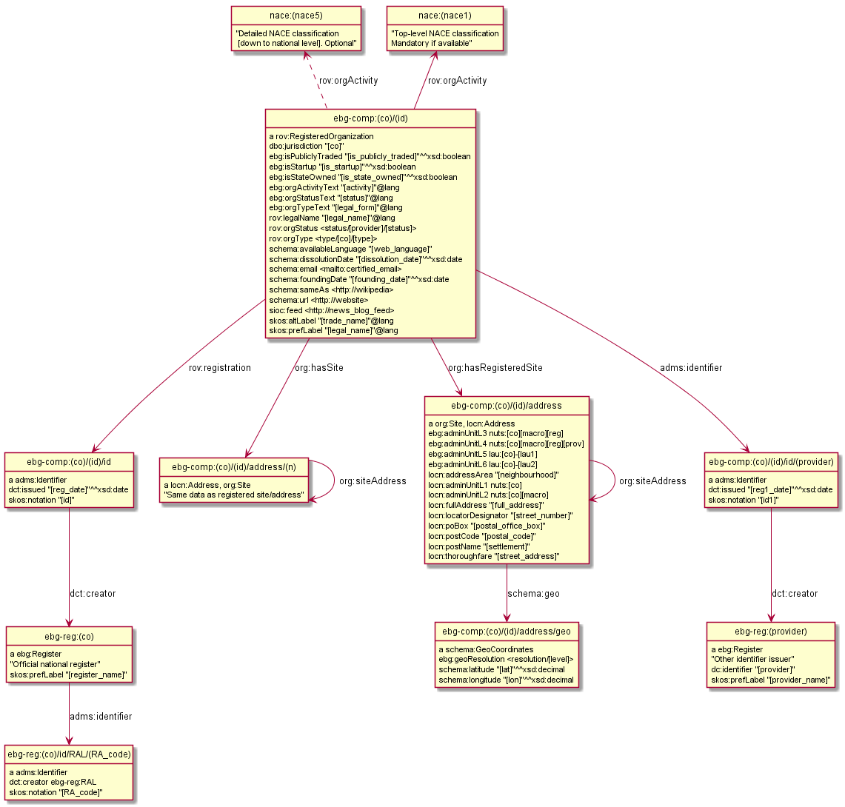
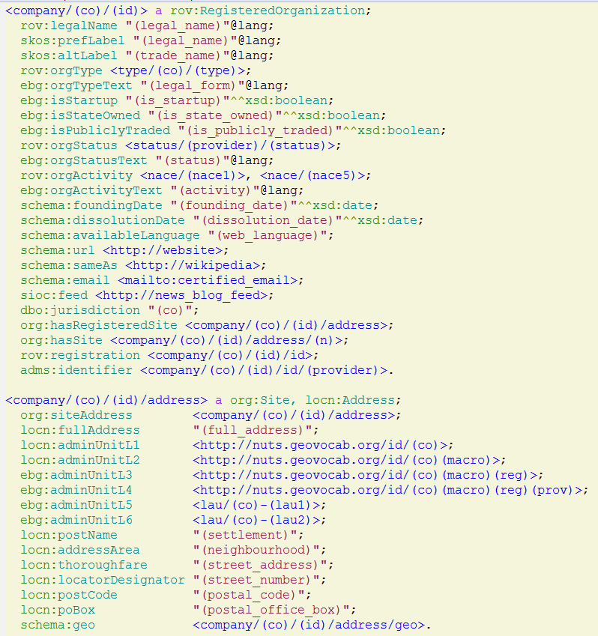
euBusinessGraph Semantic Data Model

Slide 41
RDF by Example
rdfpuml: generates diagrams from actual Turtle using PlantUML
Features to keep the diagram compact: inline types, literals, key values; collect props; arrow direction; reification, etc
Bells and whistles: line and arrow type, Stereotypes, colored circles
Applied in these domains: linguistics, companies, Panama leaks, clinical trials, museums, multimedia, video annotation…
RDF by Example: rdfpuml for True RDF Diagrams, rdf2rml for R2RML Generation. Alexiev, V. In Semantic Web in Libraries 2016 (SWIB 16), Bonn, Germany, November 2016. HTML, PDF, Video
rdf2rml: generates R2RML conversion from Turtle example
Embed table names or queries in root node; carried over to children unless new query given
Embed field names in URLs and literals; Give XSD types of literals
Generates R2RML: RDB to RDF Mapping Language script (another RDF)
Script can be used with any R2RML Implementation to convert RDBMS to RDF

Slide 42
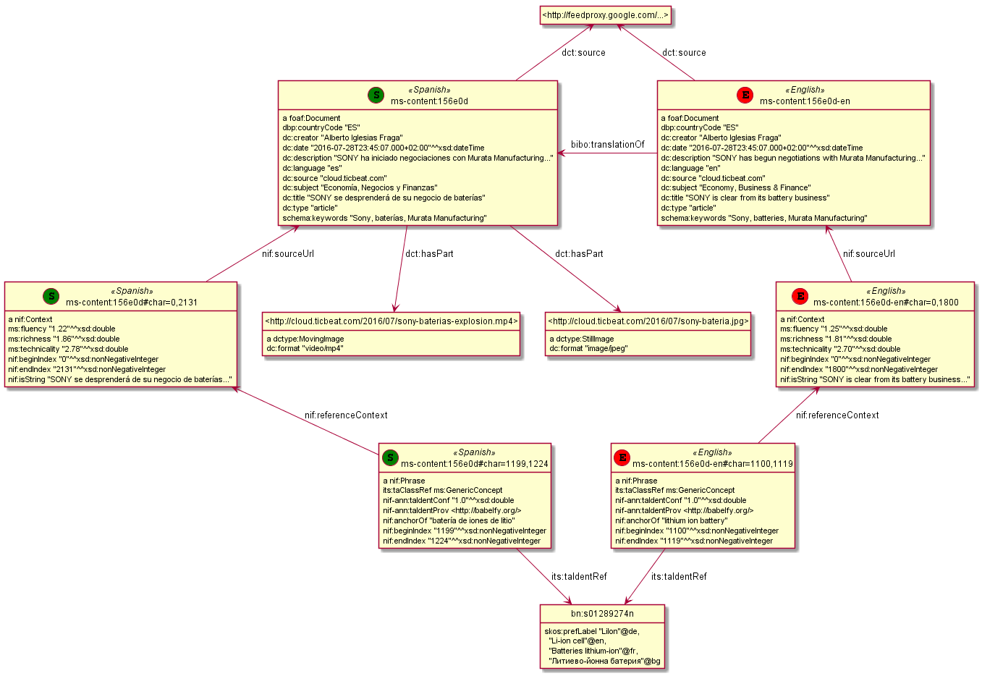
Example: News Annotation and Translation

Slide 43
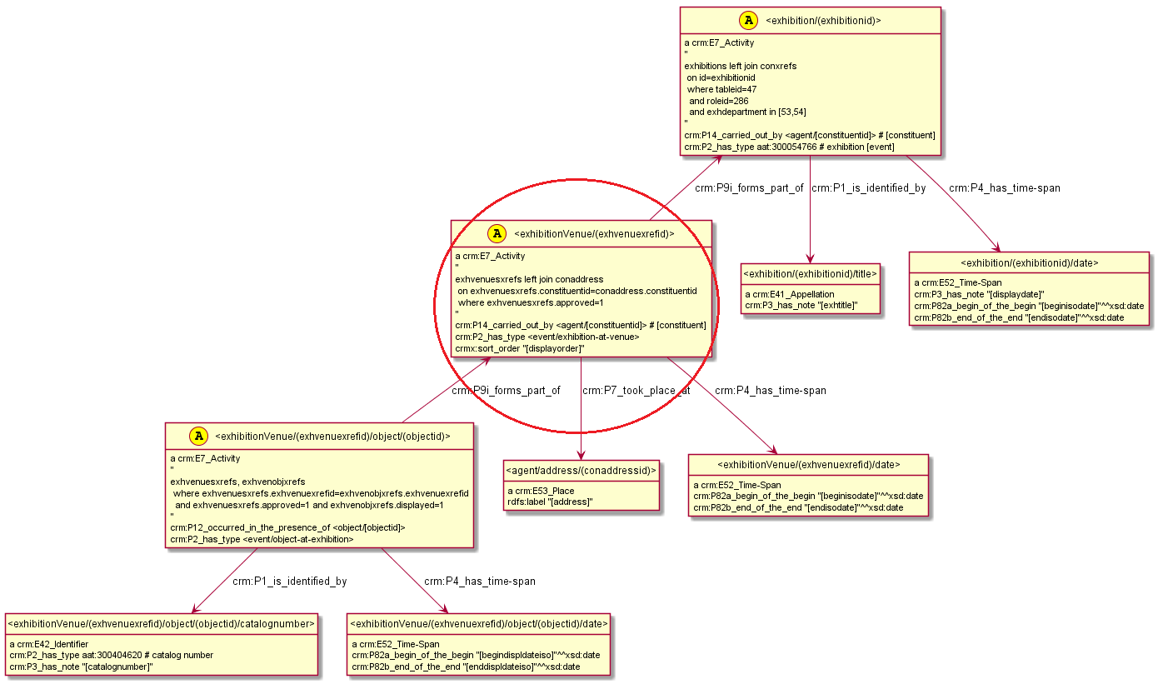
R2RML Example: Source

Slide 44
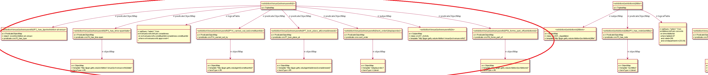
R2RML Example: Generated R2RML

Slide 45
RDF Shapes

Slide 46

RDF Shapes
Always run RIOT to check the syntax of your files (Turtle, RDF/XML, JSONLD)
But to check the shape of data, we need ShEx or SHACL
Validating RDF Data (October 2017, 328 pages), Source examples.
Describes Shape Expressions (ShEx) and Shapes Constraint Language (SHACL) using a lot of examples. Explains the rationales for their designs, compares the languages and presents some practical applications.

Slide 47
SHACL vs SHEX
ShEx is a W3C Community Group specification while SHACL Core and SHACL-SPARQL are W3C Recommendations (other parts of SHACL are W3C Notes or Community Group documents).
While this has little impact on practical use, there is some chance that commercial vendors will proceed with SHACL implementations at a higher pace than with ShEx implementations due to SHACL's "more official" status.
The expressiveness of ShEx and SHACL for common use cases is similar.
ShEx is schema-oriented, while SHACL is focused on defining constraints over RDF graphs.
ShEx has both a compact syntax and an RDF syntax. SHACL is defined as an RDF syntax, and SHACL Compact is a draft proposal. ShEx is briefer and more natural than even SHACL Compact.
ShEx has support for recursion and cyclic data models while recursion in SHACL is undefined.
This is the biggest weakness of SHACL compared to ShEx as it makes for considerably more complex translations of conceptual data models (e.g. expressed as UML diagrams)
SHACL has support for arbitrary SPARQL property paths while ShEx has support only for incoming and outgoing arcs.
SHACL has rich built-in violation reporting. ShEx provides basic violation reporting, however it outputs which nodes match which shapes.
ShEx has a language agnostic extension mechanism called semantic actions while SHACL offers extensibility through SPARQL or JavaScript.

Slide 48
SHACL Implementations
SHACL API, Java/Jena, implements SHACL-Core, SHACL-SPARQL, SHACL rules, by TopQuadrant
SHACL for rdf4j, Google Summer of Code 2017 project
RDFUnit, implements SHACL-Core, SHACL-SPARQL, also sources OWL CWA, OSLC, DSP, by AKSW University of Leipzig
SHACLex, Scala/Jena, implements SHACL Core & ShEx), by WESO University of Oviedo
Corese SHACL validator, implemented in STTL (SPARQL Template Transformation language), by INRIA
SHACL Playground, online demo, Javascript, by TopQuadrant
ELI Validator, online tool based on SHACL API, by Sparna
SHACL-Check, prototype, by Tim Berners-Lee
Alternative SHACL implementation, Python, by Peter F. Patel-Schneider

Slide 49
ShEx Implementations
shex.js for Javascript/N3.js (Eric Prud’hommeaux)
Shaclex for Scala/Jena (Weso, University of Oviedo)
shex.rb for Ruby/RDF.rb (Gregg Kellogg)
Java ShEx for Java/Jena (Iovka Boneva/University of Lille)
ShExkell for Haskell (Weso, University of Oviedo) .
Online demos and tools that can be used to experiment with ShEx:
shex.js playround
Shaclex on Heroku
ShExValidata (for ShEx 1.0)

Slide 50
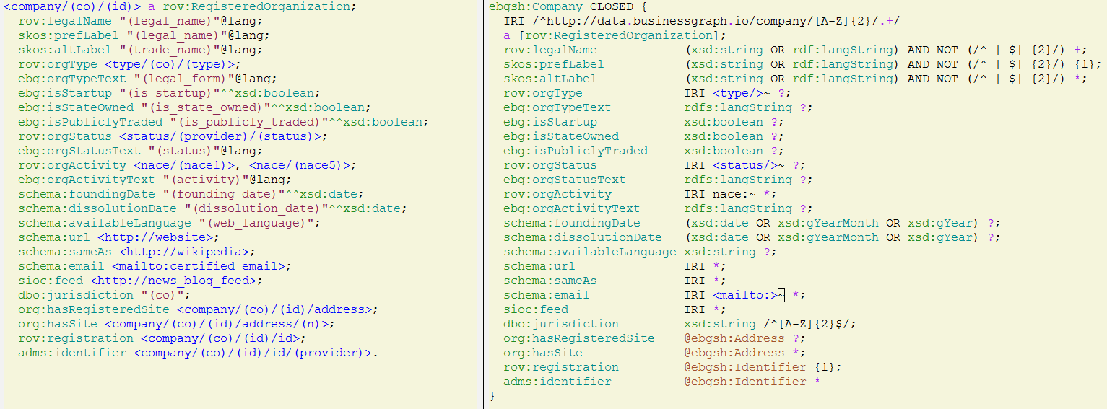
euBusinessGraph Company Model: Turtle vs ShEx
"AND NOT" are regexps requiring that names should be normalized wrt spaces

Slide 51
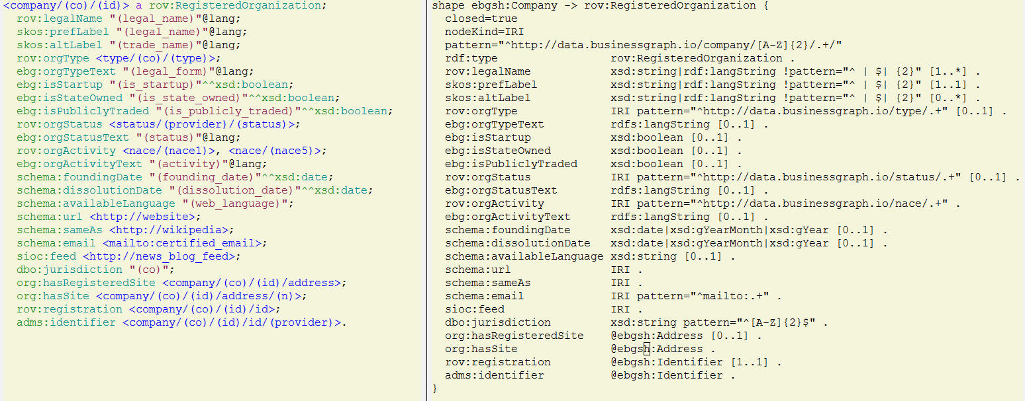
euBusinessGraph Company Model: Turtle vs SHACL Compact
Quite comparable to ShEx

Slide 52
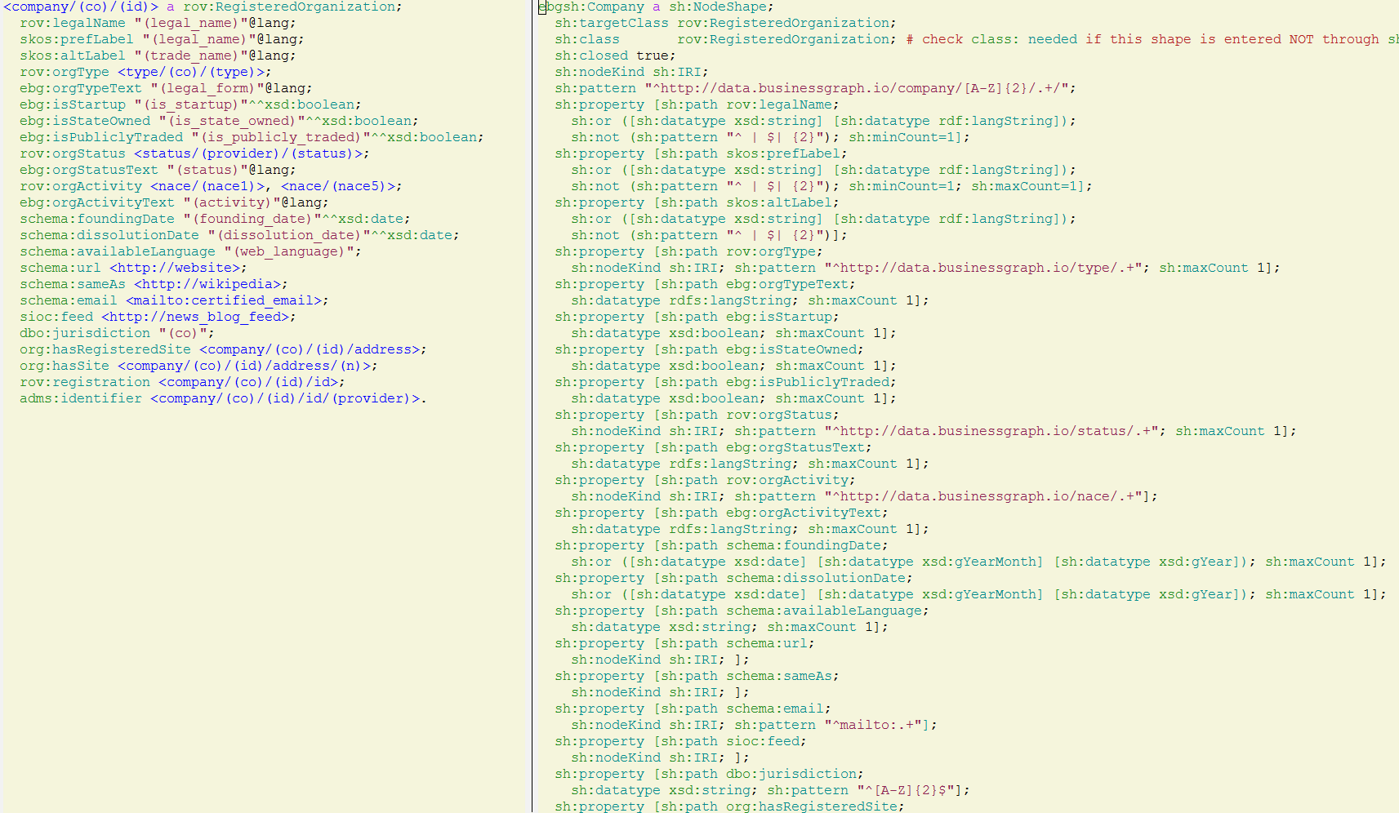
euBusinessGraph Company Model: Turtle vs SHACL

Slide 53
Org, RegOrg, Locn Ontologies

Slide 54
W3C Core eGov Vocabularies
e-Government Core Vocabs (also see Handbook on using the Core Vocabularies)
Developed by EC ISA2 SEMIC Joinup semantic interoperability initiative
Standardized by W3C
First link is to a descriptive document, second link to the namespace document:
Organization (org:): formal or informal organizations, classification, related people, events.
Registered Organization (rov:): organizations that are registered in some register.
Person (person:). Basic person info (link is to the EC descriptive PDF)
Location (locn:): addresses and geographic locations.
Public Organisation, Public Service
Evidence and Criterion

Slide 55
Organization Ontology
Generic reusable core; can be extended or specialized for use in particular situations
support linked data publishing of organizational information across a number of domains
publication of information on organizations and their structures
allow domain-specific extensions to add classification of organizations and roles
allow extensions to support neighboring information such as organizational activities
Organizational structure
decomposition into sub-organizations and units
Organizational history (merger, renaming)
purpose and classification of organizations
Reporting structure
membership and reporting structure within an organization
roles, posts, and the relationship between people and organizations
Location information: sites or buildings, locations within sites
Notes:
https://www.w3.org/TR/vocab-org/

Slide 56
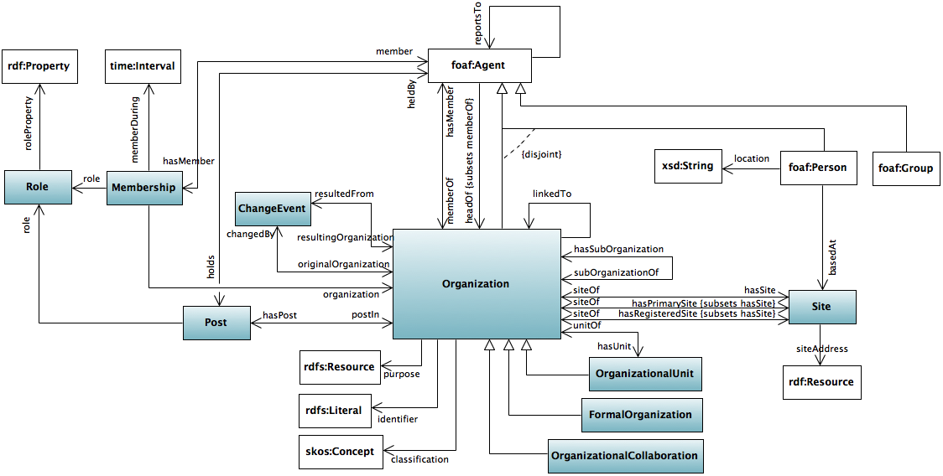
Organization Ontology

Slide 57
Org Example
Fragment of the organizational structure of the UK Cabinet Office
org:Role allows central nomenclature of roles
org:Membership is time-based, org:Post is not (and there's overlap between the two)
@base <http://reference.data.gov.uk/id/>.
<department/co> a org:Organization, central-government:Department;
skos:prefLabel "Cabinet Office" ;
org:hasUnit <department/co/unit/cabinet-office-communications> .
<department/co/unit/cabinet-office-communications> a org:OrganizationalUnit ;
skos:prefLabel "Cabinet Office Communications" ;
org:unitOf <department/co> ;
org:hasPost <department/co/post/246> .
<department/co/post/246> a org:Post ;
skos:prefLabel "Deputy Director, Deputy Prime Minister's Spokesperson" .
org:role <role/deputy-director>;
org:postIn <department/co/unit/cabinet-office-communications> ;
org:heldBy <person/161> .
<role/deputy-director> a org:Role; rdfs:label "Deputy Director" .
<person/161> a foaf:Person; foaf:name "John Smith".
<person/161/membership/123456> a org:Membership;
org:member <person/161>;
org:organization <department/co/unit/cabinet-office-communications>;
org:role <role/deputy-director>;
org:memberDuring [a owlTime:Interval; owlTime:hasBeginning [
owlTime:inXSDDateTime "2009-11-01T09:00:00Z"^^xsd:dateTime]] .

Slide 58
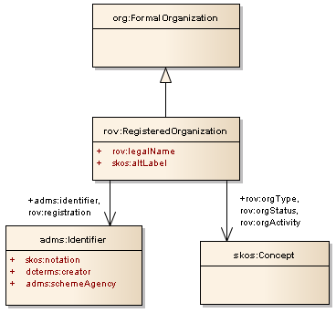
Registered Organization Ontology
Profile of the Organization Ontology for describing organizations that have gained legal entity status through a formal registration process, typically in a national or regional register.
Classes
rov:RegisteredOrganization
Properties
rov:legalName
skos:altLabel
rov:orgType
rov:orgStatus
rov:orgActivity
rov:registration
rov:hasRegisteredOrganization

Slide 59
RegOrg Example
Description of a company
a description of the organization;
a legal identifier
a further identifier (Open Corporates).
<http://business.data.gov.uk/id/company/04285910>
a rov:RegisteredOrganization ;
rov:legalName "Apple Binding Ltd" ;
rov:orgStatus <http://example.com/ref/status/NormalActivity> ;
rov:orgType <http://example.com/ref/type/Plc> ;
rov:orgActivity <http://example.com/ref/NACE/2/C/18/01/02> ;
rov:orgActivity <http://example.com/ref/NACE/2/C/18/01/04> ;
rov:registration <http://example.com/id/li04285910> ;
adms:identifier <http://example.com/id/oc04285910> ;
org:registeredSite <http://example.com/id/rs04285910> .
# Official registration
<http://example.com/id/li04285910> a adms:Identifier ;
skos:notation "04285910"^^ex:idType ;
adms:schemaAgency "UK Companies House" ;
dcterms:issued "2001-09-12"^^xsd:date .
# A supplementary identifier (Open Corporates)
<http://example.com/id/oc04285910> a adms:Identifier ;
skos:notation "gb/04285910"^^ex:OCid ;
dcterms:issued "2010-10-21T15:09:59Z"^^xsd:dateTime ;
dcterms:modified "2012-04-26T15:16:44Z"^^xsd:dateTime ;
dcterms:creator <http://opencorporates.com/> .
Notes:
https://www.w3.org/TR/vocab-regorg/#overview-of-the-vocabulary
The following is an example of a (real) company described using the Registered Organization vocabulary (in RDF/Turtle), which is also available as a separate file . This includes:
a description of the organization;
a legal identifier (i.e. details of the registration with the authority that conferred legal status);
a further identifier (Open Corporates).
We assume here that example.com is publishing information about registered organizations. This might be the company register itself or another organization.
Line 3 gives the legally registered name of the company. In some jurisdictions, especially those where there are multiple official languages, a single company may have several legal names and therefore it can be appropriate to use multiple instances of the legalName property (language tags may, of course, be added). It is noteworthy that ORG assumes that an organization can only have a single legally recognized name (which is the common case) and therefore uses skos:prefLabel for this. It is the possibility of having more than one such name in a limited number of jurisdictions, that justifies the creation of rov:legalName .
Where a company is known informally by an alternative name of some sort, or a trading name, in addition to its legal name, then skos:altLabel should be used to provide those alternatives as is done in ORG.
In lines 4 and 5, URIs identify the organization status and organization type . Different jurisdictions will typically define different values for organization status such as trading, insolvent and ceased trading. Similarly there is a wide variety of organization types such as Plc, SA and GmbH although within a given jurisdiction there will be a limited number of defined terms. Even where the terms used in different jurisdictions are lexically identical, they may have slightly different legal meanings. The controlled list of values for organization type and organization status should be encoded as a SKOS Concept Scheme so that each ones has a URI.
Registers typically record the type of activity (or multiple activities) carried out. These are normally set out in a controlled vocabulary and again, these can vary from one jurisdiction to another. The UN's ISIC Codes [ ISIC4 ] form a common starting point for several such vocabularies including the European Union's NACE [ NACE ] Codes and UK's SIC codes [ SIC07 ]. The URIs shown as the values of rov:orgActivity in lines 6 and 7 assume that NACE codes are encoded as SKOS concepts.
Line 8 carries the crucial registration property that points to an Identifier class (defined in ADMS [ ADMS ]). Although formally the Registered Organization vocabulary has no mandatory classes or properties, the defining characteristic of a registered organization is that it is formally registered. This is the property that captures that information and links to the formal registration which is described in lines 15 - 18. In this case, Apple Binding became a registered company on 12 September 2001 when UK Companies House issued it with the identifier 04285910. The identifier is typed in line with expected practice for skos:notation and the ORG ontology. Incidentally, UK Companies House publishes its information about registered companies as linked data and the example uses that URI as the subject of the description.
Line 10 shows the org:registeredSite used to point to a description of the registered address of the organization (the address information itself is not shown).
In addition to their company registration identifier, legal entities are very likely to have other identifiers associated with them, such as tax numbers, VAT numbers etc. Line 9 points to an example of an additional identifier, one that does not confer legal status (or any other status) on the company but that is potentially useful as an identifier.

Slide 60
Location Ontology
Example from EBG model
Uses EC NUTS and LAU admin levels (levels 3..6 are EBG extensions)
Emphasizes URL structure (carving)
Extended with geo info
I personally don't see the need for both Site and Address
<company/(co)/(id)/address> a org:Site, locn:Address;
org:siteAddress <company/(co)/(id)/address>;
locn:fullAddress "(full_address)";
locn:adminUnitL1 <nuts/(co)>;
locn:adminUnitL2 <nuts/(co)(macro)>;
ebg:adminUnitL3 <nuts/(co)(macro)(reg)>;
ebg:adminUnitL4 <nuts/(co)(macro)(reg)(prov)>;
ebg:adminUnitL5 <lau/(co)-(lau1)>;
ebg:adminUnitL6 <lau/(co)-(lau2)>;
locn:postName "(settlement)";
locn:addressArea "(neighbourhood)";
locn:thoroughfare "(street_address)";
locn:locatorDesignator "(street_number)";
locn:postCode "(postal_code)";
locn:poBox "(postal_office_box)";
schema:geo <company/(co)/(id)/address/geo>.
<company/(co)/(id)/address/geo> a schema:GeoCoordinates;
schema:latitude "(lat)"^^xsd:decimal;
schema:longitude "(lon)"^^xsd:decimal;
ebg:geoResolution <resolution/(level)>.

Slide 61
SPARQL

Slide 62
SPARQL Specifications
SPARQL 1.1 Overview
SPARQL 1.1 Query Language: query constructs, biggest doc
SPARQL 1.1 Update: how to insert/delete and manipulate graphs
SPARQL1.1 Service Description: ontology for describing endpoint capabilities, ties with VOID
SPARQL 1.1 Federated Query: calling (executing patterns on) other endpoints
SPARQL 1.1 Query Results JSON Format: JSON format for SELECT
SPARQL 1.1 Query Results CSV and TSV Formats: tabular format for SELECT
SPARQL Query Results XML Format: XML format for SELECT
SPARQL 1.1 Entailment Regimes: interplay between inference and SPARQL
SPARQL 1.1 Protocol: making queries by HTTP
SPARQL 1.1 Graph Store HTTP Protocol: manipulating graphs with simple HTTP verbs

Slide 63
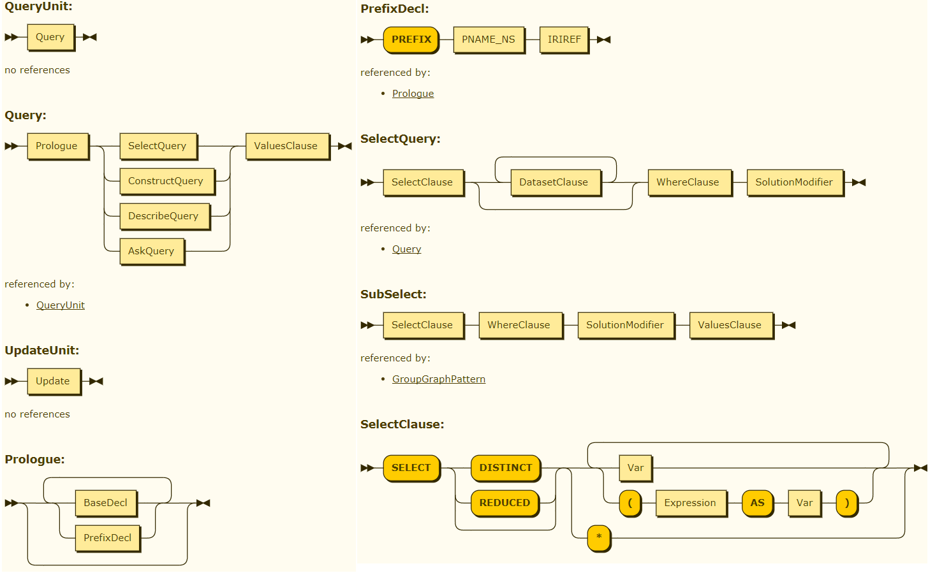
SPARQL Syntax Diagrams
Railroad diagrams: I use them often for reference

Slide 64
SPARQL Visualization, Helper Tools
Data Visualization with GraphDB and Workbench: Report, Presentation
SPARQL completion, builtin Workbench visualizations
Using results from Google Sheets
Invoking SPARQL Queries, endpoint URL, query parameters
Tools to Help With Writing SPARQL Queries: dataset exploration, Controlled Natural Language
Statistical visualizations based on W3C Data Cube Ontology
Graph Visualizations
Visualization Toolkits
Data Access API

Slide 65
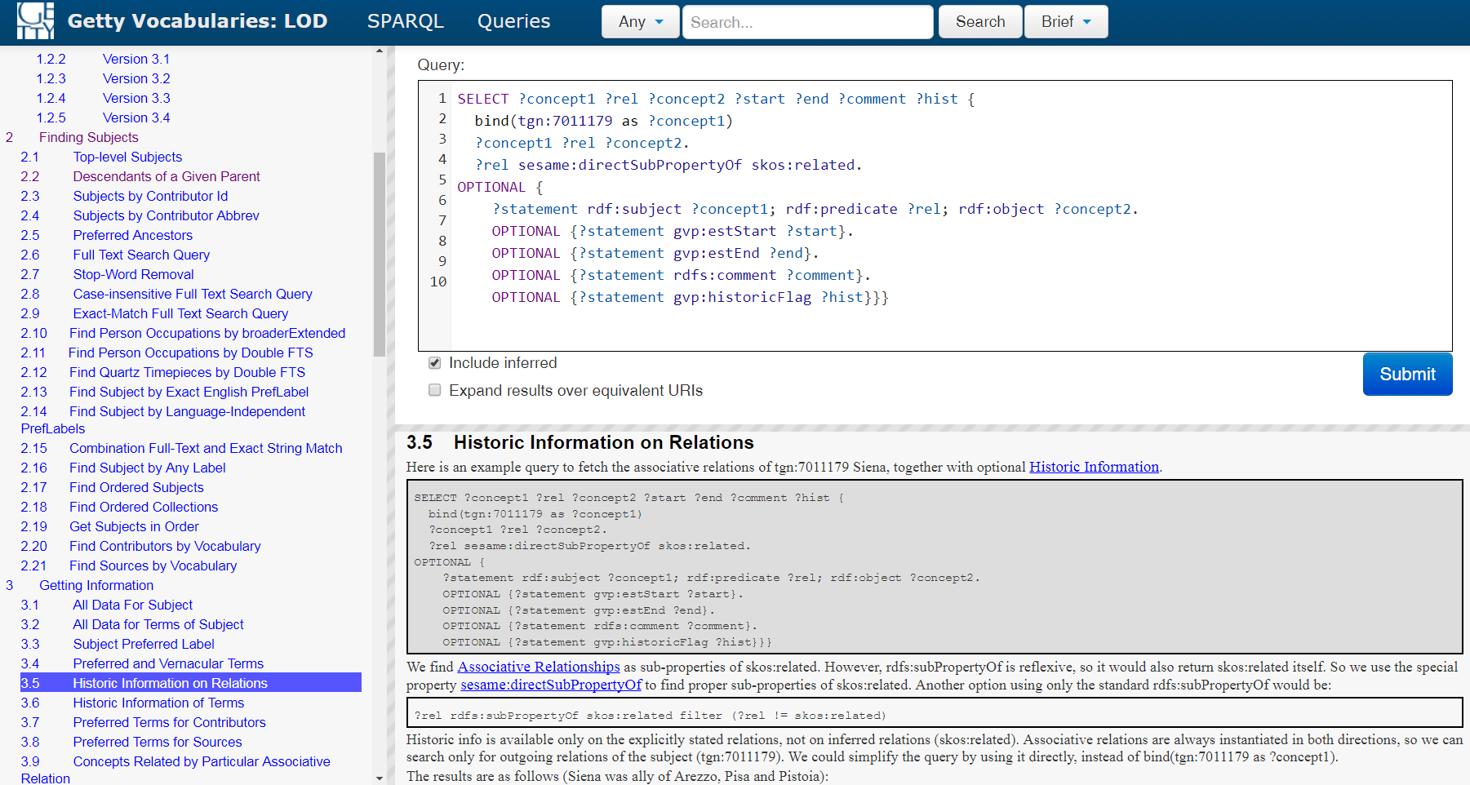
Learn From Getty Sample Queries
First read doc, then try sample queries

Slide 66
SPARQL Update
Graph Operations
LOAD: load from file to graph
CLEAR: delete all triples in graph
CREATE: make empty graph (in GDB when you make the first quad that also makes the graph)
DROP: remove graph (in GDB is same as CLEAR)
COPY: copy graph to another
MOVE: rename graph
ADD: add triples from one graph to another
Triple Operations
INSERT DATA: insert constant triples
DELETE DATA: delete constant triples
DELETE: delete matching triples. Where clause binds variables, delete pattern says which triples
INSERT: insert matching triples
DELETE/INSERT: delete then insert (i.e. modification)

Slide 67
Extension: GeoSPARQL
GraphDB supports the GeoSPARQL standard
Topology predicates and functions over complex geometries
Supports 3 topology algebras (formalisms)
E.g. find points in polygon
PREFIX my: <http://example.org/ontology#>
PREFIX geo: <http://www.opengis.net/ont/geosparql#>
PREFIX geof: <http://www.opengis.net/def/function/geosparql/>
SELECT ?f WHERE {
?f my:hasPointGeometry / geo:asWKT ?fWKT .
FILTER (geof:sfWithin(?fWKT, "Polygon ((-83.4 34.0, -83.1 34.0, -83.1 34.2, -83.4 34.2, -83.4 34.0))"^^geo:wktLiteral))
}

Slide 68
Extension: Facets and Full-Text-Search
GraphDB connectors synchronize selected data to:
Lucene GraphDB connector (standard)
Elasticsearch GraphDB connector (enterprise)
Solr GraphDB connector (enterprise)
Create index(es), GraphDB keeps them in sync
SPARQL INSERT DATA
The '''literal''' is JSON configuration
ElasticSearch connection info
List types to start from
Property chains to follow
Field name to index as
PREFIX inst: <http://www.ontotext.com/connectors/elasticsearch/instance#>
INSERT DATA {
inst:org-activity :createConnector '''
{
"elasticsearchCluster": "bgtr",
"elasticsearchClusterSniff": true,
"elasticsearchNode": "localhost:9300",
"manageIndex": true,
"bulkUpdateBatchSize": 1000,
"manageMapping": true,
"fields": [{
"fielddata": true,
"indexed": true,
"stored": true,
"multivalued": true,
"analyzed": false,
"fieldName": "activity",
"propertyChain": [
"http://www.w3.org/ns/regorg#orgActivity",
"http://www.w3.org/2004/02/skos/core#broaderTransitive"]}],
"types": [
"http://www.w3.org/ns/regorg#RegisteredOrganization"
]}
''' .
}

Slide 69
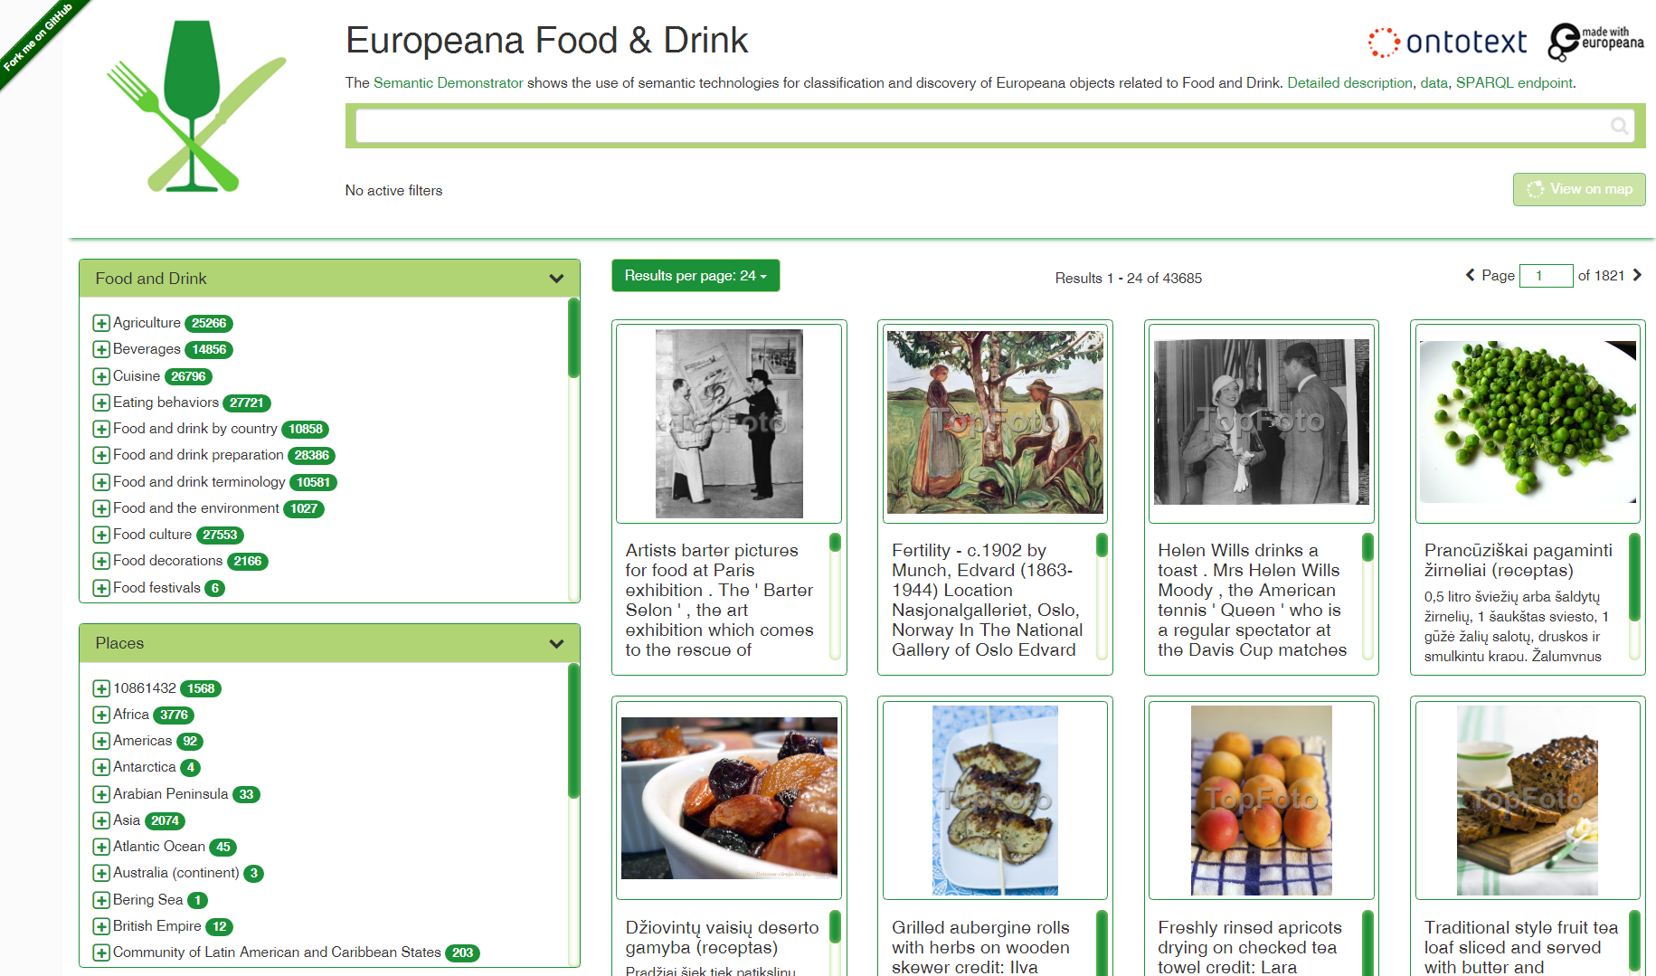
Semantic Facets
Example: Europeana Food and Drink Semantic App

Slide 70
Full-Text Search
First create some FTS indexes using a GraphDB connector
Getty Examples
2.6 Full Text Search Query ?Subject luc:term "fishing* AND vessel*";
2.7 Stop-Word Removal
2.8 Case-insensitive Full Text Search Query
2.9 Exact-Match Full Text Search Query ?Subject luc:term ' "arts crafts" ' ?Subject luc:term luc:term """ "Hà So'n Bình, Tỉnh" """;
Autocomplete plugin
select * {graph ?g {
?s <http://www.ontotext.com/plugins/autocomplete#query> "онтотекст"}}

Slide 71
IoT and WoT

Slide 72
Sensor Ontologies
Linked Open Vocabularies is a nice discovery service (won award at ISWC 2017)
Search "sensor" on LOV finds many IOT-related ontologies (sorted by occurrences):
stac, ssn, spt, demlab, aws, m3lite, w3c, qu, sosa, dogont, san, ssno, km4c, pep, ha, earth, iot, lite, dicom, saref, ceo, hw, oml, om, seasd, shw, ispra, exif, rami, acm, cogs, datex, edac, frbrer, hto, ioto, obo, omn, op, pmlp, prvt, s4ee, sam, samfl, smg...
Tag "IoT" on LOV finds 9 ontologies, 1177 classes, 254 properties

Slide 73
ISO 15926
ISO standard for description of complex machinery, including design, characteristics, assembly and interconnections, exploitation and maintenance, etc
https://en.wikipedia.org/wiki/ISO_15926
https://www.posccaesar.org/wiki/ISO15926
http://15926.org/.
Gellish: A Generic Extensible Ontological Language - Design and Application of a Universal Data Structure (2005)
Excellent book that describes the idea of Generic Modeling underlying ISO 15926
Describes data in comprehensive tabular structures, very similar to RDF

Slide 74
Web of Things
WoT applies the web architecture (including RDF, JSONLD, JS, URIs, HTTP) to IoT
The idea is to standardize IOT capabilities, protocols and communication using web technologies.
Very interesting and timely: specs are just now coming out, there's very strong industry support.
"Web of Things seeks to counter the fragmentation of the IoT through standard complementing building blocks (e.g., metadata and APIs) that enable easy integration across IoT platforms and application domains."
Adapts payload for constrained devices:
Efficient XML Interchange (EXI) instead of XML
Constrained Application Protocol (CoAP) instead of HTTP
Composition: https://www.w3.org/WoT/: main page
https://www.w3.org/WoT/IG/ (interest group): free discussion on a wide range of topics
https://www.w3.org/WoT/WG/ (working group): focused discussion on topics with enough consensus, so a Recommendation can be reached.
"The WG Charter covers those aspects that the IG believes are mature enough to progress to W3C Recommendations."

Slide 75
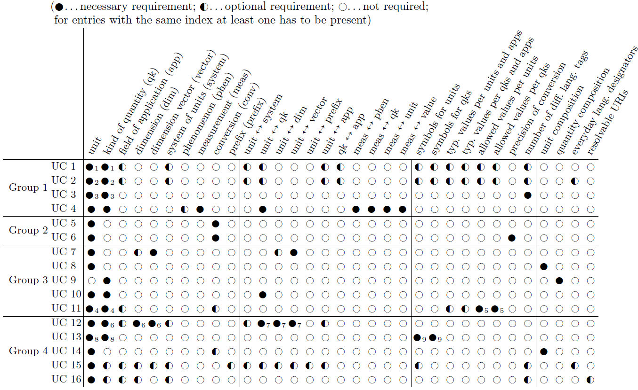
Units of Measure Ontologies (1)
Use Cases and Suitability Metrics for Unit Ontologies (OWLED ORE 2016)
Defines 16 use cases and 33 features
Evaluates 7 UoM ontologies against these criteria
It's worth starting here to survey the field

Slide 76
Units of Measure Ontologies (2)
MUO (2008): project on mobile environments
OBOE 1.0: represent scientific observations
OM 1.8.2 (2016-03): developed in the context of food research (Wageningen)
Semantic support for quantitative research, PhD thesis (Wageningen 2013)
Ontology of Units of Measure and Related Concepts (SWJ 2012)
QU (2011): based on OMG SysML 1.2 QUDV and UN/CEFACT Rec 20 (SSN WG)
QUDT 1.1: developed in the context of NASA projects
SWEET 2.3: developed in the context of NASA projects for Earth observation
UO+PATO (2016): modules of the OBO family of life science ontologies
The Units Ontology: a tool for integrating units of measurement in science (Database 2012)
MQ (2016): project SEAS (smart energy aware systems) (ttl)
Representation of Multi-Dimensional Quantities, Time-Series, and More (draft 2016)
LINDT, UCUM, CDT (2018): continuation of MQ, projects SEAS, OpenSensing

Slide 77
UNCEFACT, QUDT
unit:MilliSecond
rdf:type qudt:DerivedUnit , qudt:TimeUnit ;
qudt:quantityKind qudt-quantity:Time ;
rdfs:label "Millisecond"^^xsd:string ;
qudt:symbol "ms"^^xsd:string ;
qudt:abbreviation "ms"^^xsd:string ;
qudt:code "1616"^^xsd:string ;
qudt:uneceCommonCode "C26"^^xsd:string ;
qudt:conversionMultiplier "0.001"^^xsd:double ;
qudt:conversionOffset "0.0"^^xsd:double ;
skos:exactMatch <http://dbpedia.org/resource/Millisecond> .
unit:SystemOfUnits_USCustomary qudt:systemDefinedUnit unit:MilliSecond.
unit:DegreeCelsius
rdf:type qudt:DerivedUnit , qudt:TemperatureUnit , qudt:SIUnit ;
rdfs:label "Degree Celsius"^^xsd:string ;
qudt:abbreviation "degC"^^xsd:string ;
qudt:code "0515"^^xsd:string ;
qudt:conversionMultiplier "1"^^xsd:double ;
qudt:conversionOffset "273.15"^^xsd:double ;
qudt:symbol "degC"^^xsd:string ;
skos:exactMatch <http://dbpedia.org/resource/Celsius> .
unit:DegreeFahrenheit
rdf:type qudt:TemperatureUnit , qudt:NotUsedWithSIUnit ;
rdfs:label "Degree Fahrenheit"^^xsd:string ;
qudt:abbreviation "degF"^^xsd:string ;
qudt:code "0525"^^xsd:string ;
qudt:conversionMultiplier 0.5555555555555555556E0 ;
qudt:conversionOffset 255.37037037037037037E0 ;
qudt:symbol "degF"^^xsd:string .
UNCEFACT Rec20 code list (Excel)
Commonly used, e.g. in GoodRelations (eCommerce)
Latest I got is rec20_Rev11e_2015.xls
QUDT (Quantities, Units, Dimensions, Data Types): I have most experience with it
Developed by TopQuadrant for NASA Exploration Initiatives Ontology Models project, now is a foundation to maintain and evolve
Current: QUDT 1.1: about 12 vocabs, most important is OVG_units-qudt-(v1.1).ttl.
Future: QUDT2: about 80 vocabs, broken down by discipline
Includes conversion factors
Includes UNECE (UNCEFACT) code and link to DBpedia

Slide 78
LINDT, UCUM, CDT
LINDT, UCUM, CDT (2018)
Projects SEAS, OpenSensing
Supporting Arbitrary Custom Datatypes in RDF and SPARQL, ESWC 2016
Spec: datatype discovery, custom datatypes
Jena implementation: datatype discovery, custom datatypes. Features:
Overload SPARQL compare operators (=, <, etc.)
Overload algebraic functions (+, -, *, /) between measurement literals and/or scalars (numbers)
Custom SPARQL function cdt:sameDimension()
Cast to XSD numeric datatypes
Playground (see next)
"1 %"^^cdt:dimensionless # percent
"1 [ppth]"^^cdt:dimensionless # parts per thousand
"1 [ft_i]"^^cdt:length # foot, International customary units
"1.0 [ft_br]"^^cdt:length # foot, British Imperial lengths
"10e-1 um"^^cdt:length # micrometer
"-2.47e-4 L/(min.m2)"^^cdt:ucum # liter per minute and square meter
"0.7 km/s"^^cdt:speed # kilometer per second
"10.54 %"^^cdt:dimensionless # percents
"1.5647e6 {rbc} "^^cdt:dimensionless # red blood cell count
"37.5 Cel"^^cdt:temperature # degree Celsius
"2.45e-1 [in_i'Hg]"^^cdt:pressure # inch of mercury column
"2.45e-1 m[Hg].[in_i]/m"^^cdt:pressure # inch of mercury column
"1 atm"^^cdt:pressure # standard atmosphere
"1 att"^^cdt:pressure # technical atmosphere

Slide 79
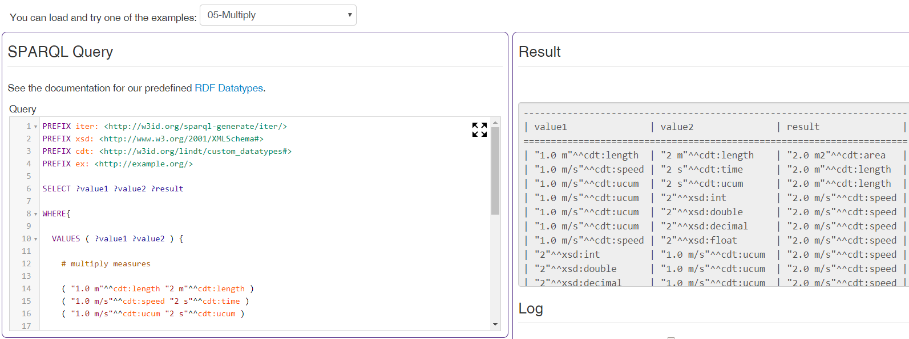
LINDT, UCUM, CDT Playground

Slide 80
Aside: Semantic Web Journal
Semantic Web Journal is an open journal that is highly valuable in our field
Founded in 2010 by Pascal Hitzler
Open reviews, one can see excellent feedback and has early access even to drafts
Substantive and interesting papers
Focused calls on systems, datasets, ontologies, etc.
Top papers by total citations
Matthew Horridge, Sean Bechhofer, The OWL API: A Java API for OWL Ontologies, Semantic Web 2(1), 2011, 11-21.
Barry Bishop, Atanas Kiryakov, Damyan Ognyanoff, Zdravko Tashev, and Ruslan Velkov, OWLIM: A family of scalable semantic repositories, Semantic Web 2(1), 2011, 33-42.
Top papers by average annual citations
Jens Lehmann, Robert Isele, Max Jakob, Anja Jentzsch, Dimitris Kontokostas, Pablo N. Mendes, Sebastian Hellmann, Mohamed Morsey, Patrick van Kleef, Sören Auer, Christian Bizer, DBpedia - A Large-scale, Multilingual Knowledge Base Extracted from Wikipedia, Semantic Web 6(2), 2015, 167-195.
Matthew Horridge, Sean Bechhofer, The OWL API: A Java API for OWL Ontologies, Semantic Web 2(1), 2011, 11-21.
Barry Bishop, Atanas Kiryakov, Damyan Ognyanoff, Zdravko Tashev, and Ruslan Velkov, OWLIM: A family of scalable semantic repositories, Semantic Web 2(1), 2011, 33-42.
Kalina Bontcheva, Dominic Rout, Making Sense of Social Media Streams through Semantics: a Survey, Semantic Web 5(5), 2014, 373-403.

